Slide 1
PACIO-eLTSS Use Case
Functional status, cognitive status & Long-term services and support
4/17/20

Slide 2
Patient Persona
Betsy smith johnson

Slide 3
Social History
Ms. Betsy Smith-Johnson is a 68-year-old white female widow
Retired 3 years ago
Moved from Maryland to Texas.
Prior to her retirement, she worked as a receptionist in a hotel lobby
Depends on her social security check as her primary source of income
Patient lives alone
Remains independent in her Activities of Daily Living (ADLs)
Functionally independent with a cane
Drives her own car to get to medical appointments
Had become increasingly reliant on friends to drive her, due to intermittent dyspnea and blurry vision in her right eye
She has two children, a son and a daughter
Daughter works as an accountant in Maryland, is married and has children
Son lives alone and works as a lawyer nearby in Texas
Son assists with healthcare decisions, although communication is poor between family members
Recently started a transportation service to attend medical appointments and for running errands
Son is getting married in three months and patient’s goal is to dance at the wedding

Slide 4

Past Medical History
Patient leads a sedentary lifestyle and follows a poor diet with little exercise, which is a result of low health literacy and multiple comorbidities. Patient has also started to experience frequent falls due to the osteoarthritis of the right hip. Patient was diagnosed with the following while she was in Maryland:
• Hypertension
• Depression
• Hyperlipidemia
• Cataracts
• Stage 3 chronic kidney disease
• Osteoarthritis
• Ischemic heart disease
• Type II diabetes

Slide 5
Current Medications
Patient has a complex medication list, which contributes to poor adherence. Medications are:
• Lisinopril 40mg twice a day
• Glargine 24 units SQ nightly
• Atorvastatin 40mg nightly
• Insulin 3 units with each meal
• Calcium 500mg daily
• Sertraline 25mg nightly
• Vitamin D 800IU daily
• Tylenol 650mg every 6 hours or as needed
• Furosemide 20mg daily
• Ferrous Sulfate 325mg three times a day prior to meals

Slide 6
Typical Healthcare Follow Up
Patient does follow up with the primary care physician (PCP) and nephrologist regularly, but other specialist follow up is often sporadic. The PCP has been central to the patient’s healthcare information management.
• PCP
• Cardiologist
• Endocrinologist
• Nephrologist
• Psychiatrist
• Ophthalmologist
• Retail Pharmacy
• Lab Services

Slide 7
Use Case
Scenes

Slide 8
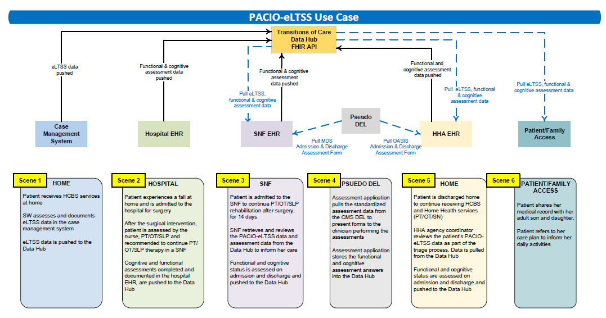
Use Case Overview

Slide 9
Scene 1: Home
Patient is at home currently receiving the following LTSS Services:
Home modification: Install grab bars in shower-1 time install-performed by contractor
Non-emergency transportation: 2 trips per month
Diabetes education sessions at home: Weekly for 3 months
Physical therapist sessions: 30 mins a week for 6 months
The Social Worker documents the following in the case management system:
Personal Goals:
Improve balance skills
Dance at son’s upcoming wedding
Assessed Needs:
Needs health / nutrition education for diabetes
Lack of access to transportation
Depression (under treatment)
Strengths:
Able to manage bills
Independent walking with cane
Preferences:
Remain on ICWP and continue with her current services
Risk:
At risk for falls
Patient is on depression medication which may cause drowsiness
eLTSS information is pushed from eLTSS Server to the Data Manager

Slide 10
Scene 2: Hospital Encounter
Ms. Smith-Johnson has as a right hip replacement in the hospital and is assessed by the Physical Therapist (PT), the Occupational Therapist (OT) and Nurse after surgery
Initially, patient has strict precautions for her right hip, which includes minimizing flexion of the right hip and right knee. There is an order for her to be “Toe Touch” for weight bearing activity.
As patient nears discharge, PT/ OT reassesses function for discharge planning and the nurse assesses cognition. The following information is documented:
Function:
Patient requires partial assistance to maintain hip precautions with bed mobility. She requires substantial assistance to maintain toe touch weight bearing when walking 12 steps with 2 turns using a walker. Patient can use a bedside commode with 1 person providing substantial assistance to maintain toe touch weight bearing assist her in getting out of bed. Patient requires supervision or touching assistance when completing self care activities.
Goals: Return to her baseline functional status (independent with a cane) and dance at her sons wedding
Cognition:
Nurse assesses patient’s cognition by completing the Montreal Cognitive Assessment (MOCA) and the Confusion Assessment Method (CAM)
Cognitive and functional assessments completed during the hospital encounter in PAC Assessment App
PAC Assessment App pushes assessments through Structured Data Capture to EHR/Database
EHR/Database System pushes assessments to the Data Manager

Slide 11
Scene 3: Skilled Nursing Facility (SNF)
Ms. Smith-Johnson was admitted from the hospital to the SNF to continue the Physical Therapist (PT) and Occupational Therapist (OT) rehabilitation after surgery, for 14 days.
Goals: Ms. Smith-Johnson’s goal remains the same as in the hospital to return to her baseline functional status (independent with a cane), dance at her sons wedding and return home once she can safely do so.
Ms. Smith-Johnson’s functional status and cognitive status was assessed and documented within the first 3 days of admission using the assessment scale on the Minimum Data Set (MDS). Depression noted via MDS PHQ-9.
Once it was determined that Ms. Smith-Johnson could return home safely with home health care to continue her PT/OT and skilled nursing, discharge planning was initiated by the Social Worker (SW).
An MDS assessment of Ms. Smith-Johnson’s functional status and cognitive status was completed assessing her usual performance within the 3 days prior to discharge. PT and OT to continue at home. Depression remains under treatment
The SNF clinicians retrieve and review the eLTSS data and assessment data from the Data Manager to inform her care
Functional and cognitive information on admission was pushed to the Data Manager by the SNF System.
Functional and cognitive information on discharge was pushed to the Data Manager by the SNF System.

Slide 12
Scene 4: Pseudo Centers for Medicare and Medicaid Services (CMS) Data Element Library (DEL)
SNF:
The assessment application pulls the standardized assessment data from the CMS DEL and presents forms to the clinician performing the assessments
Home Health Agency (HHA):
The assessment application pulls the standardized assessment data from the CMS DEL and presents forms to the clinician performing the assessments
The assessment application stores the SNF functional and cognitive assessment answers into the Data Manager
STRETCH GOAL: The assessment application stores the HHA functional and cognitive assessment answers into the Data Manager

Slide 13
Scene 5: Home
Patient is accepted to the HHA and is discharged home from the SNF. She receives both Home Health services and LTSS services.
Ms. Smith-Johnson’s LTSS, functional and cognitive status history were reviewed by PT/OT/SLP/SN. PT/OT/SLP/SN formally assesses Ms. Smith-Johnson at the Start of Care using the assessment scale on the Home Health Outcome and Assessment Information Set (OASIS).
Once it was determined that Ms. Smith-Johnson was meeting her functional status performance goals in PT/OT/SLP/SN, discharge plans from HHA were initiated.
A discharge OASIS functional assessment was completed. Patient continued LTSS services after being discharged from the HHA.
The HHA agency coordinator reviews the patients PACIO-eLTSS data as part of the triage process
STRETCH GOAL: Completed functional and cognitive assessments are pushed to the Data Manager.

Slide 14
Scene 6: Patient Family Access
Patient shares her medical record with her adult son who is helping to provide assistance in the home. Patient also shares data with her adult daughter who lives at a distance but who wants to be supportive of her mother The patient retrieves and reviews her care plan to inform her daily activities
eLTSS, Cognitive and Functional assessments are retrieved from the data manager

Slide 15
Background Information
CMS Assessments and the Data Element Library
The IMPACT Act requires the reporting of standardized patient assessment data with regard to quality measures and standardized patient assessment data elements (SPADEs). The Act also requires the submission of data pertaining to measure domains pertaining to resource use, and other domains. In addition, the IMPACT Act requires assessment data to be standardized and interoperable to allow for exchange of the data among post-acute providers and other providers. The Act intends for standardized post-acute care data to improve Medicare beneficiary outcomes through shared-decision making, care coordination, and enhanced discharge planning.¹
To receive funding from CMS, Post Acute Care (PAC) providers are required to complete assessments at specified intervals. The assessment instruments that collect this data are: The Long-Term Care Hospital CARE Data Set (LCDS) for LTCHs, the Minimum Data Set (MDS) for SNFs, the Outcome and Assessment Information Set (OASIS) for HHAs, and the Inpatient Rehabilitation Facility Patient Assessment Instrument (IRF PAI) for IRFs.
PACIO is leveraging the standardized section GG and section C from these assessment instruments to share functional status and cognitive status information from one setting to the next. The associated CMS and LOINC codes can be found in the CMS Data Element Library.
Functional status is not currently standardized across the healthcare ecosystem
Functional status observations are not standardized across healthcare and are often captured in free text. In some cases, the observations are documented using dropdown menus or unique items are selected. If a coded concept is used, it is typically limited to local codes.
CMS is standardizing several aspects of functional status in PAC. Section GG and section C are examples of assessments standardized across PAC settings.
Cognitive assessments
Some aspects of cognitive function may be captured using specified validated instruments. PACIO is demonstrating the sharing cognitive status information through use of these instruments. These instruments may be patient reported or observations by a clinician. The instrument may have each individual question coded along with the answers coded; only the score may be coded; it may be locally coded; or the instrument may not be coded at all. For the purpose of this IG, PACIO is only sharing cognitive instruments that use LOINC codes.
¹ https://www.cms.gov/Medicare/Quality-Initiatives-Patient-Assessment-Instruments/Post-Acute-Care-Quality-Initiatives/IMPACT-Act-of-2014/IMPACT-Act-of-2014-Data-Standardization-and-Cross-Setting-Measures

Slide 16
Real World Limitations/Assumptions
The following limitations/ assumptions are made for this use case:
Acute-care hospital are required to report functional status to CMS; therefore, for the purpose of the connectathon, the hospital in our scenario will be using sample data that mimics post acute care.
Each post-acute care setting has a specific workflow to gather functional status observations from multiple providers, over a specified period. These multiple observations are reviewed as a single submission from the setting.
CMS does not require the assessments to be submitted at the time of discharge; therefore, a discharge assessment may or may not be completed at the time of transfer. For the purpose of the connectathon PACIO will assume that the functional status portion of the assessment instruments are available at the time of discharge from each setting.
We decided to use the MDS LOINC codes for the questions and answers for both SNF and Home Health. We decided to identify this as a known issue and will discuss the data model and approaches at connectathons.

